Slide 1
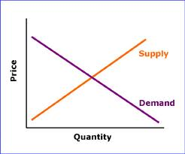
SUPPLY & DEMAND

Slide 2
Demand
Demand is the combination of desire, willingness and ability to buy a product. It is how much consumers are willing to purchase at specific prices.
The Law of Demand is the rule stating that more will be demanded at lower prices and less at higher prices.

Slide 3
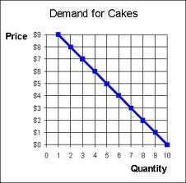
Demand Curve
Demand can either be shown on a Demand Schedule or a Demand Curve. It shows an inverse relationship between price and quantity demanded.

Slide 4
Supply
Supply is the schedule of quantities offered for sale at all possible prices in a market. It is how much producers are willing to supply at specific prices.
The Law of Supply is the rule stating that more will be offered for sale at high prices than at lower prices.

Slide 5
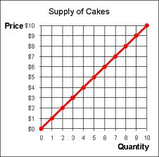
Supply Curve
Supply can either be shown on a Supply Schedule or a Supply Curve.

Slide 6
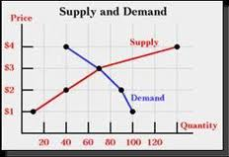
Equilibrium Point
The Equilibrium Point is where Supply & Demand intersect. That is considered the Market Price. Any price above the equilibrium price creates a surplus. A price below the equilibrium price creates a shortage.

Slide 7
Non-price Factors Affecting Demand
There are also “non-price factors that affect the demand for a good. These cause changes in demand, rather than changes in quantity demanded.
Changes in Demand (shifts of the curve) are caused by:
Change in income
Change in tastes, preferences
Price of complementary goods
Price of substitute goods
People’s expectations for the future and the number of consumers in the marketplace.

Slide 8
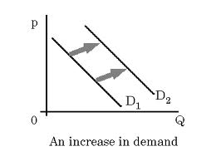
Increase in Demand

Slide 9
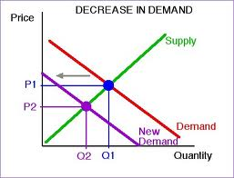
Decrease in Demand

Slide 10
Non-price Factors Affecting Supply
There are also “non-price factors that affect the supply of a good. These cause changes in supply, rather than changes in quantity supplied.
Changes in Supply (shifts of the curve) are caused by:
Change in production
Change in the cost of resources
Producer’s expectations
Competition

Slide 11
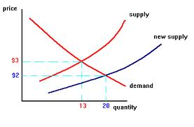
Increase in Supply

Slide 12
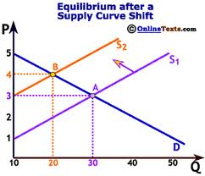
Decrease in Supply

Slide 13
Production Costs
Production costs also affect supply:
Fixed Cost – remains the same regardless of the amount produced.
Variable Cost – changes as the level of production changes.
Total Cost = FC + VC
Marginal Cost – the additional cost of producing one more unit of output.

